Slide 1
SI -4 M&M IndustrialAutomation
Module 1 Introduction

Slide 2
This Module:
General Course Information
Introduction PLC
PLC Operation.
CODESYS IDE
Practical
CODESYS IDE Installation
Running your first application “OvenSimulation”.
Next Assignments

Slide 3
General Course Information
During class:
Max 2 Teaching hour: theory - instruction
Rest of the time practical researching or working on the assignments
Deliverables and Grading. Max. 2 students in a group. You’re allowed to work alone.
Assignments* : all graded with sufficient to pass!
2 assignments Introduction
2 assignments Advanced ( M2M Students)
No written exam, results of the assignments will be the final mark. U S G O
You’re allowed to discuss the problems with other students, but you handed in your own work individually
Submission: A separated pdf of the report and a separated *.PROJECTARCHIVE file of your project solution(*.PROJECT). You’ll be informed about the deadlines.
Life demo or a screen recording of the assignments is required.
Copying other people’s work and presenting it as your own is considered fraudulent and will be reported to the exam board.
Note:
This course is mainly research based. There are abundance of information about CODESYS and Structured Text on Internet, YouTube.

Slide 4
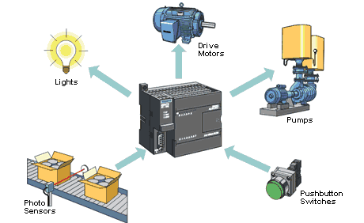



Introduction PLC
Historically, PLCs were, in fact, logic controllers, so they were really good at Boolean on/off, “check-a-photo-eye”, “turn-on-a-motor”, “close-a-liquid-valve” kind of stuff.
The addition of Servos, PID loops, Analog control, Communications and database access have ‘complicated’ the issue.
Automotive Industry
Process Industry
Petrochemical Industry

Slide 5
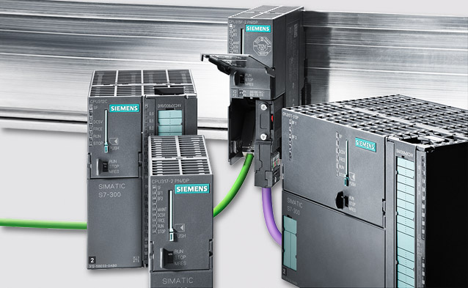
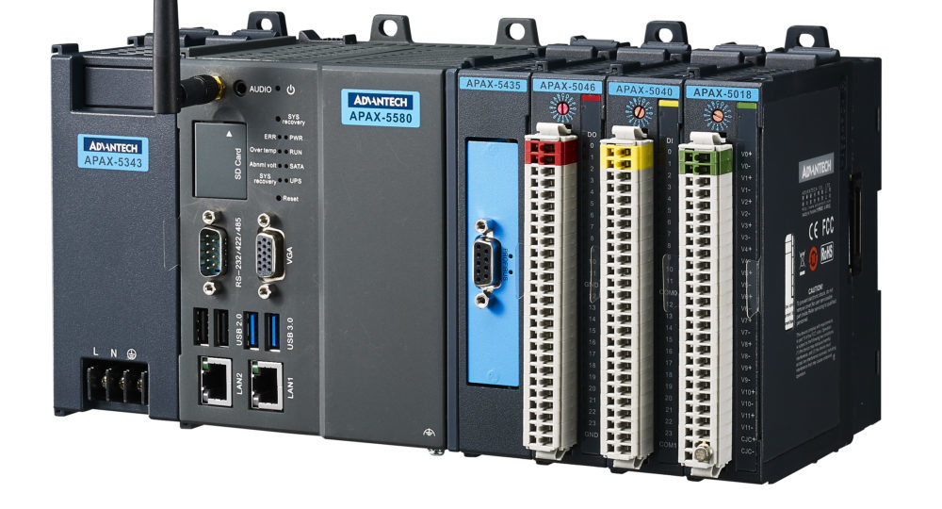
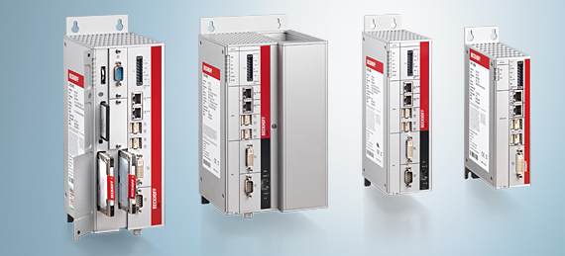
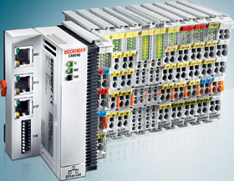
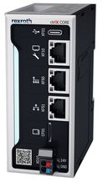
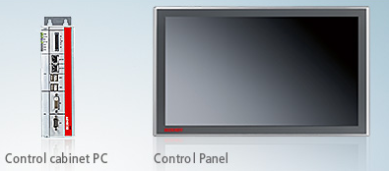
Introduction PLC
PLC, PAC or IPC ? What’s in a name.
“OEMs or system integrators say they've discovered that Programmable Automation Controllers (PACs) do better than Programmable Logic Controllers (PLCs) or Industrial Personal Computers (IPCs)?”
Perhaps not so surprisingly, the answer lies in a grey area, depending on how those in industry distinguish between the technologies.
PLC
PAC
IPC or EPC
Core

Slide 6
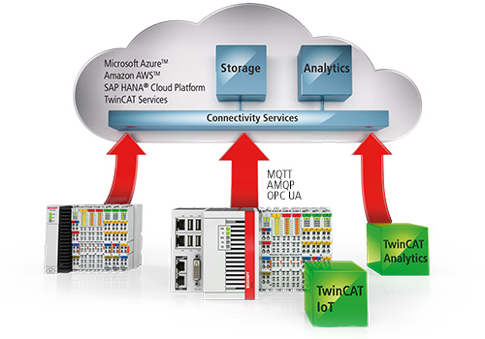
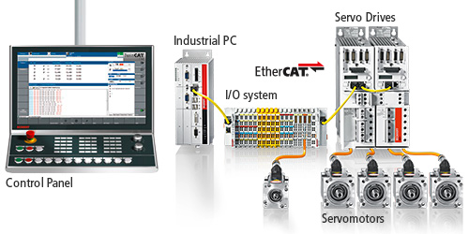
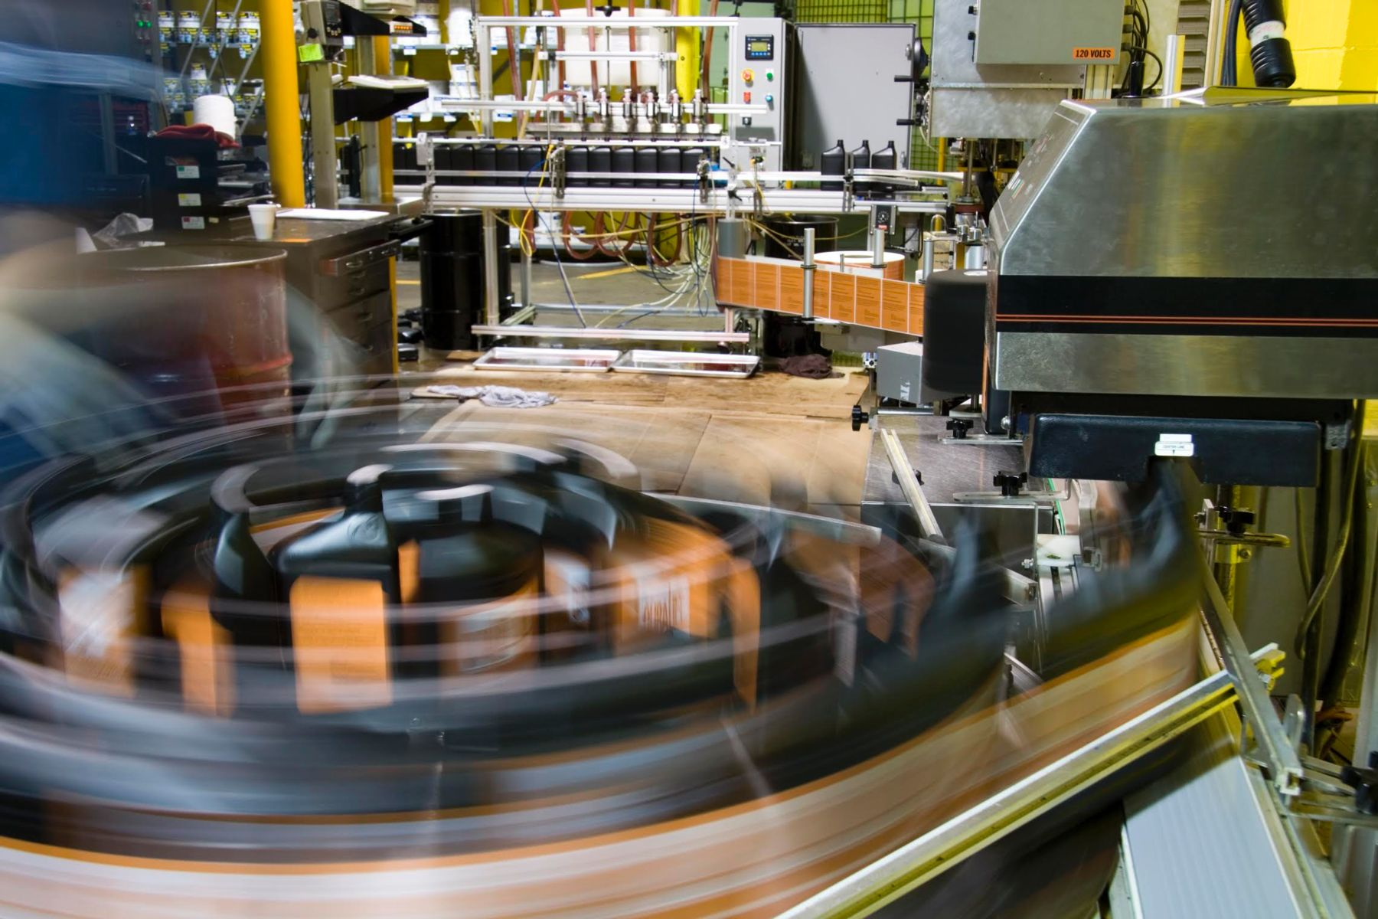
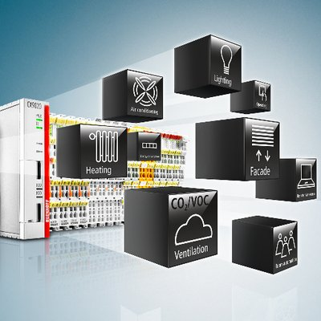

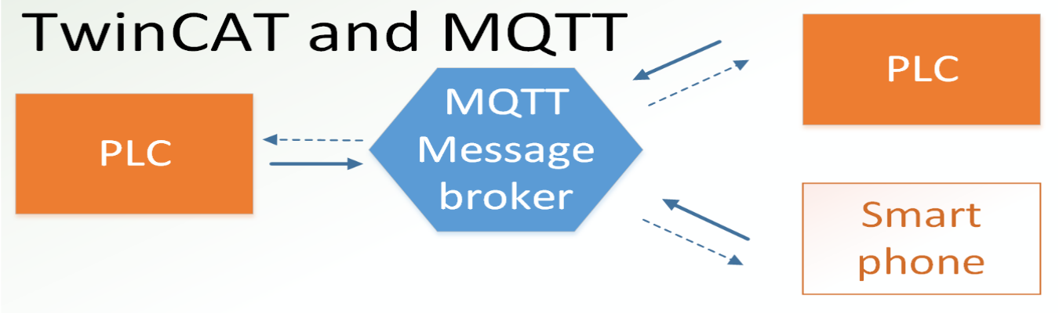
Introduction PLC
Application examples
PLCs are used in many machines, in many industries. PLCs are designed for multiple arrangements of digital and analogue inputs and outputs, extended temperature ranges, immunity to electrical noise, and resistance to vibration and impact.
A PLC is an example of a "hard" real-time system since output results must be produced in response to input conditions within a limited time, otherwise unintended operation will result.

Slide 8
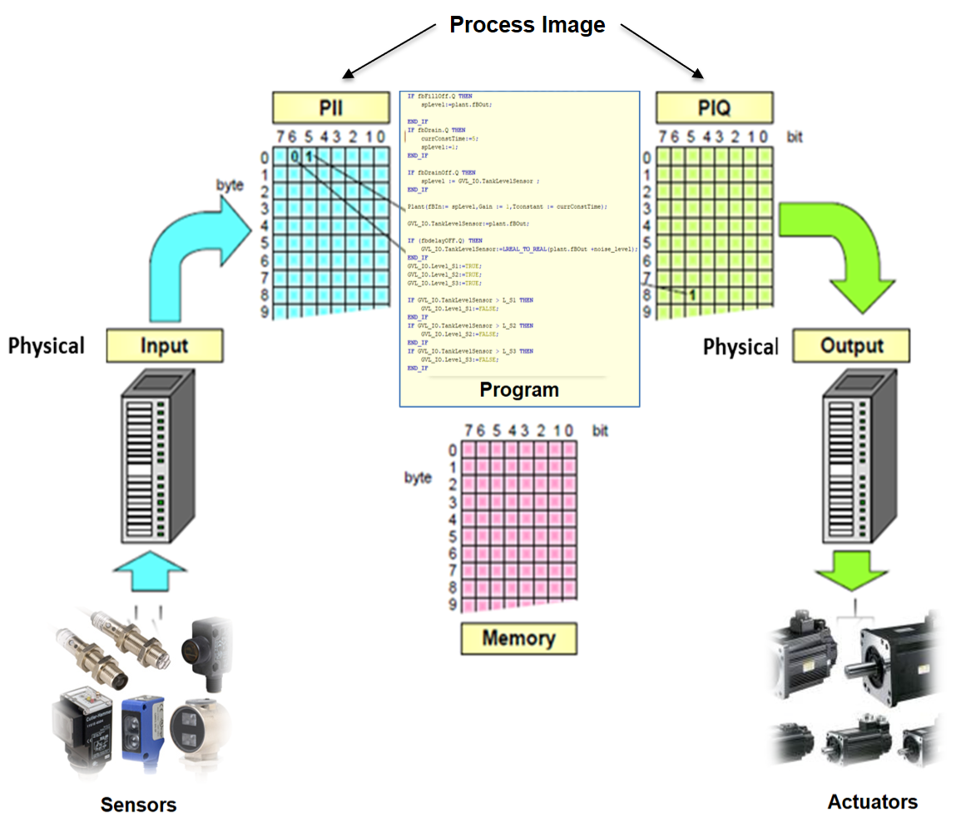
Introduction PLC
Operation
A process is in continual change.
Even though the process has approached a stationary state, for instance, the fluid level in the tank has reached 80%, there will be disturbances in the form of pressure‐drop in tubing, changed withdrawal of fluid and the like, that require that the PLC continually monitor the state of the input signals and correct the output signals.
Notes:
In order not to reduce the update frequency of outputs, the PLC does not wait for new values to be available, but rather continues with the next operation in the cycle.
This means that even though the physical values change continually, the same measured value can be used many times before an updated value is accessible in the memory.
Why copy the values to memory instead of reading the values where they are used in the program code?
There are two reasons for this.
First, it is quicker to read in all the values in the same operation. More importantly, this avoids possible problems when the same input address is used at several places in the program code.
If the state of the input changes during the course of program execution, this can have serious consequences for the result of the program. A minor disadvantage of having the input values read simultaneously is that the system overlooks input pulses of a duration shorter than the total scan time (cycle time).

Slide 9
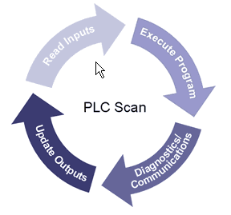
Introduction PLC
Operation
Read inputs
In this operation, input status is copied over to memory.* How long this takes depends on the number of input modules and the number of inputs at each module that is in use. Analog inputs take significantly longer to read since this involves digitization of the analog values.
Program execution
During program execution, internal variables and output addresses are updated in the memory.* The physical change in output values, however, is not changed until the final operation.
Internal Processing or Diagnostics & Communications
A PLC always checks its own state before it performs user‐related operations. If a response from hardware such as I/O or communications modules is lacking, the PLC gives notice of this by setting one or more flags.
Update Outputs
In this last operation in the cycle, the output memory* is read so that the state and values of the digital and analog outputs are updated.
* The area in memory used for copying the inputs and outputs of the PLC is often called image.

Slide 10
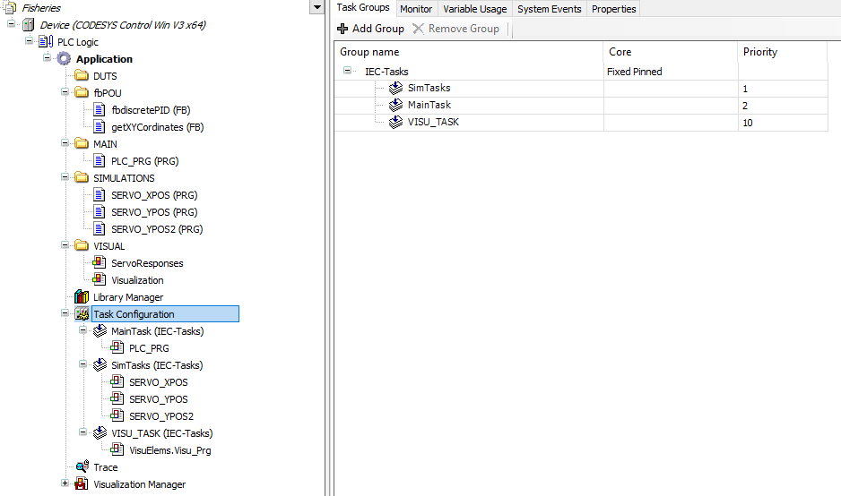
Introduction PLC
Operation
Each cycle of operations is called a scan, and the time it takes the system to perform a scan is called the scantime or the cycle time.
Is proportional to the size of the program, memory capacity.
Control of the way the program is executed is achieved by associating the program to a task.

Slide 11
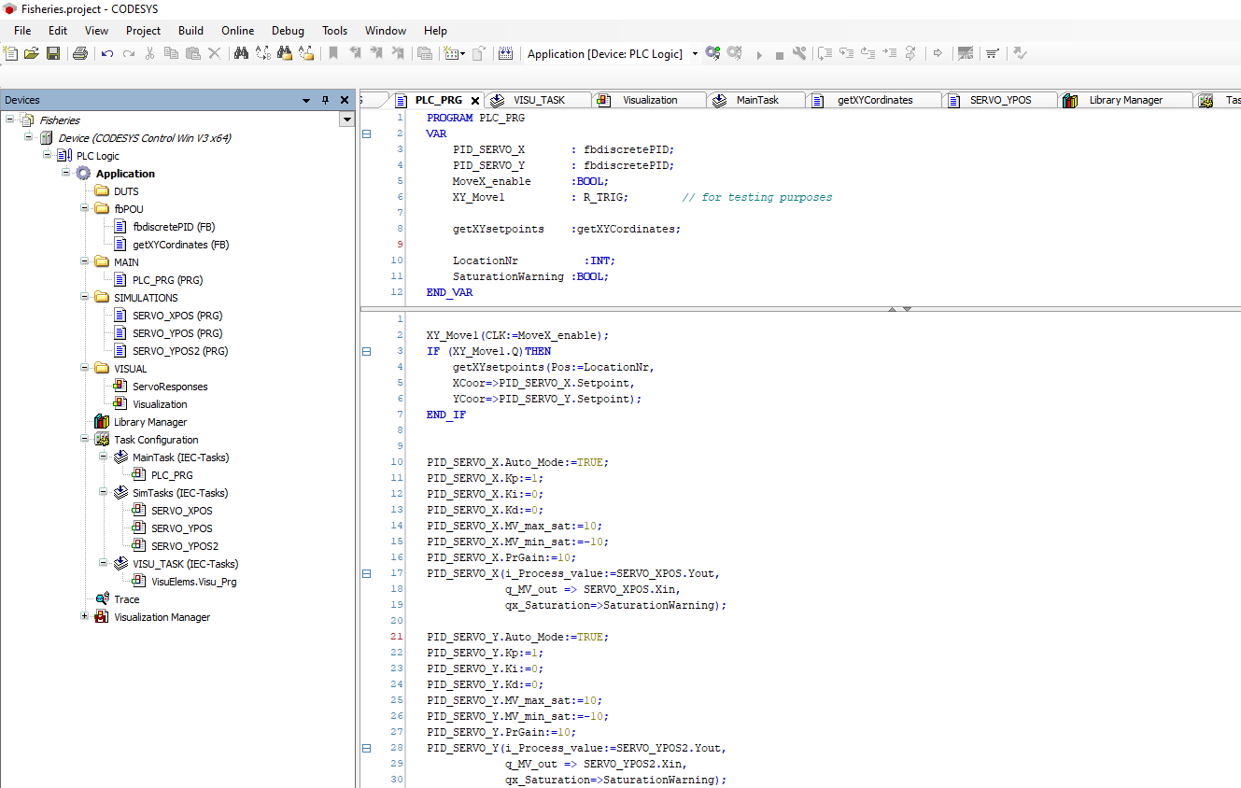
CODESYS IDE
Software

Slide 12
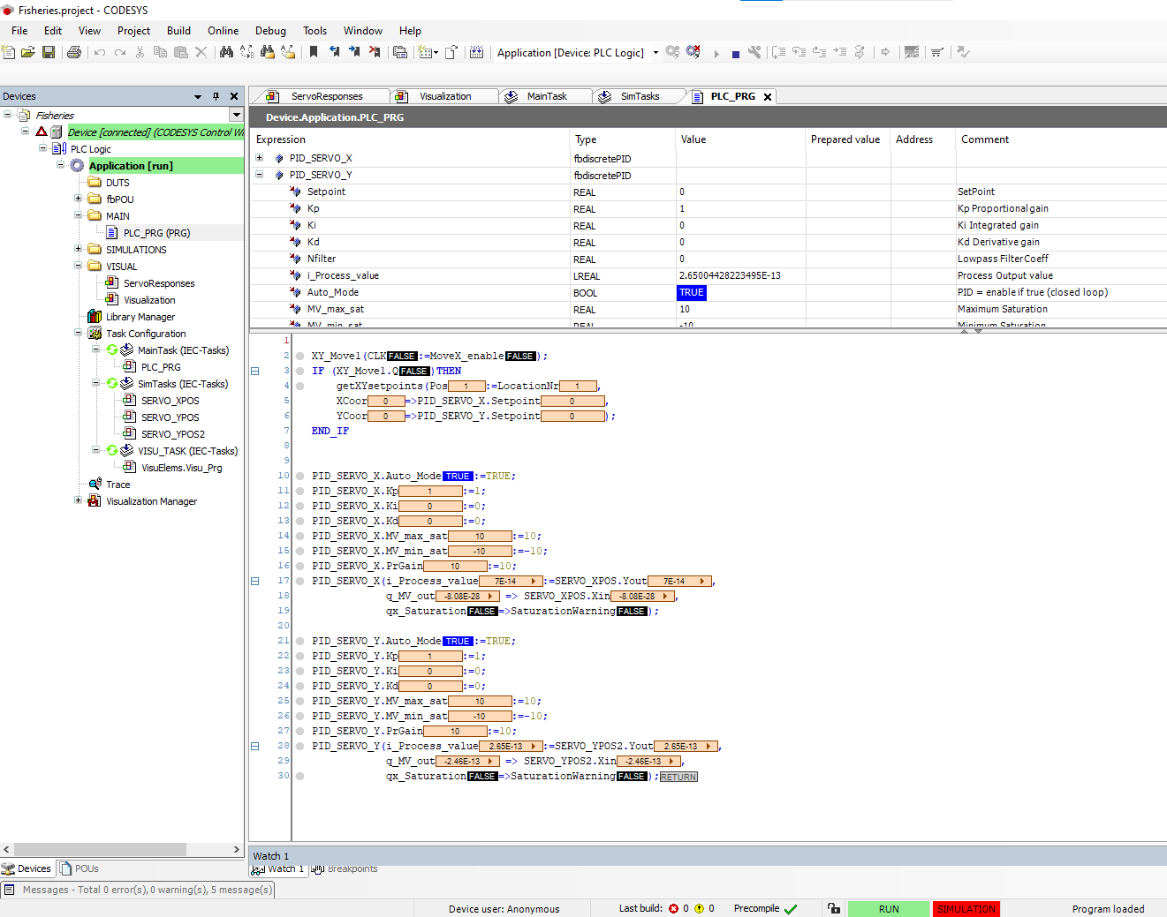
CODESYS IDE
Software
Online monitoring/debugging for the structured text (ST) programming language.

Slide 13
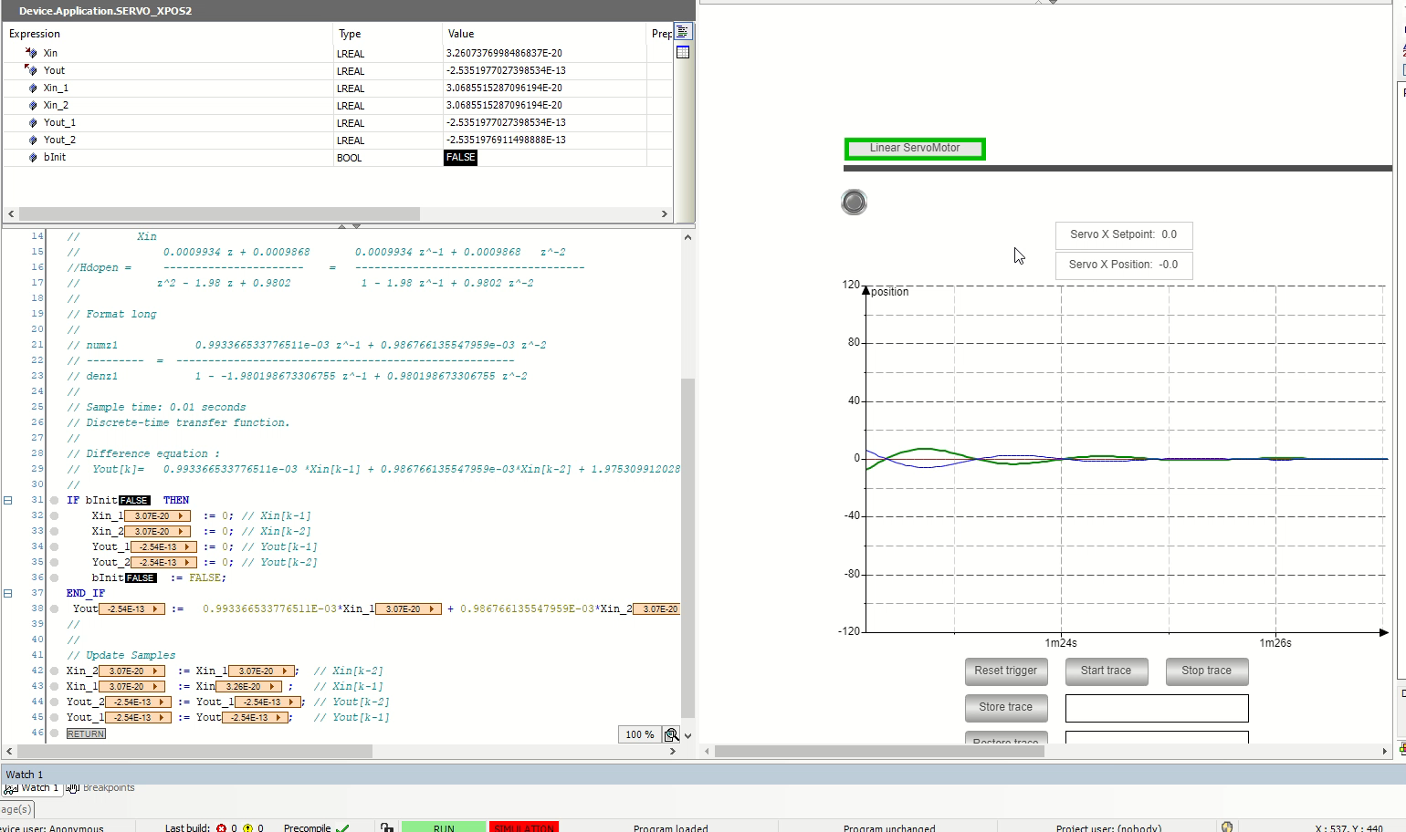
CODESYS IDE
Application Example: Monitoring a PID Controller response of a Linear Servo system (Simulated)

Slide 14
CODESYS IDE
Installation
CODESYS IDE Installation:
Acquiring knowledge to do a proper installation of a development software in general is also a skill that we’ll expect from you, please read all instructions very carefully, make sure that your windows OS is up to date.
CODESYS application can be found here for download : https://store.codesys.com/en/
A copy of CODESYS installation software is also available here on Fontys server ( login using your i-account *@fhict.nl)
https://www.fhict.nl/docent/downloads/Semester4_softwares/CODESYS/

Slide 15
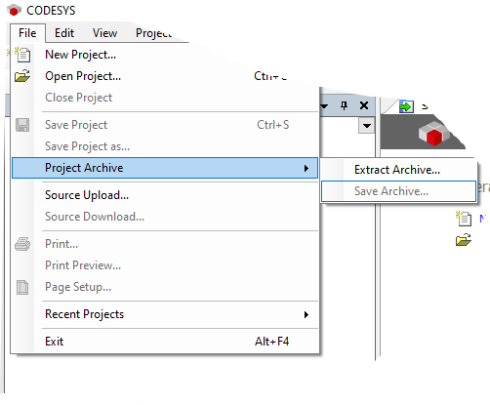
Running your first application “OvenSimulation”
Extract Archive: OvenSimulation.projectarchive
and open Project: OvenSimulation.project

Slide 16
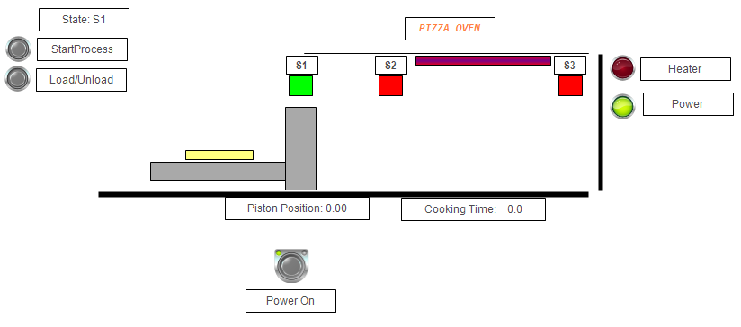
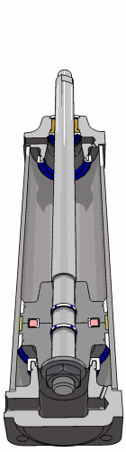
Running your first application: “OvenSimulation”
raw pizza
sensor
sensor
sensor
moving plate
Driven by a pneumatic cylinder
pneumatic cylinder

Slide 17
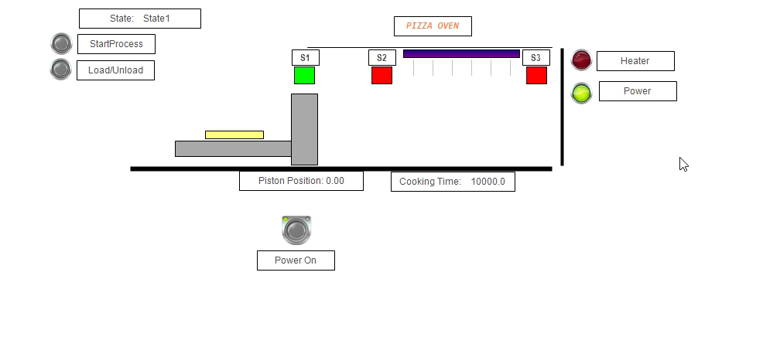
Running your first application: “OvenSimulation”

Slide 18
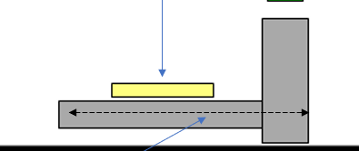
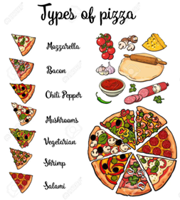
Next assignment preview
Proposal: a new pizza transporter with adjustable plate height
and a movable plate driven by linear servos
Raw pizza
adjustable plate height
Horizontal moving plate driven by a linear servo
Pizza | Xpos | Ypos | temperature | Cook Time | Air-flow
Bacon | 45 | 2 | 165ºC | 15 min | ON
Salami | 60 | 5 | 175ºC | 12 min | OFF
Mozzarella | 55 | 5.5 | 170ºC | 13 min | OFF

Slide 19
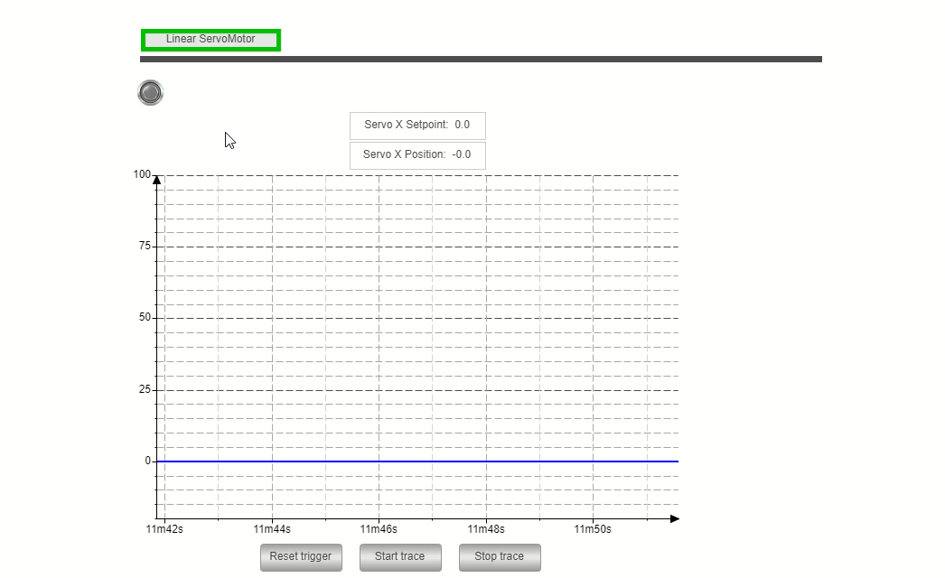
Tuning the P-Controller for horizontal movable pizza plate of the proposed Pizza Transporter

Slide 20
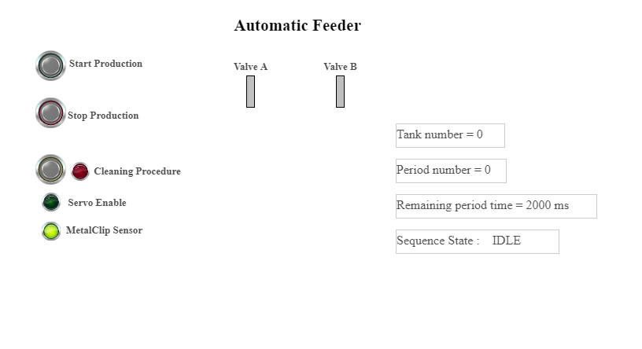
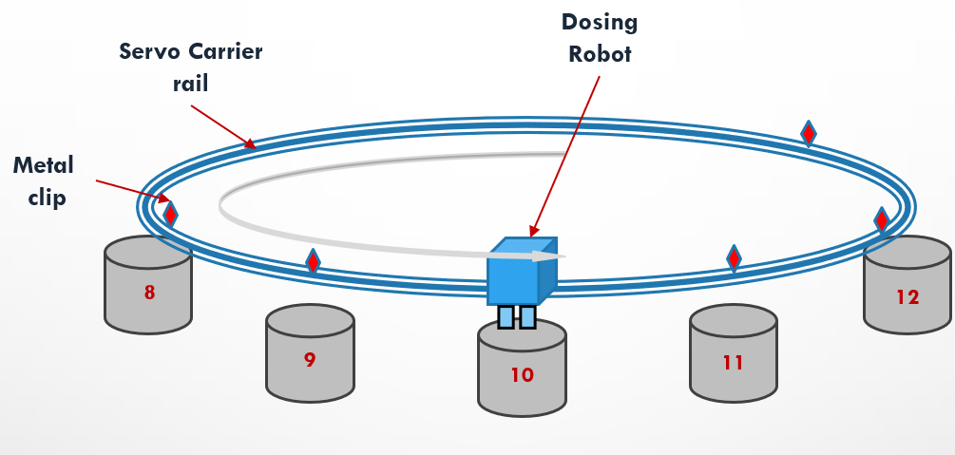
assignment preview – adv. Part animated
Automatic Feeder

Slide 21
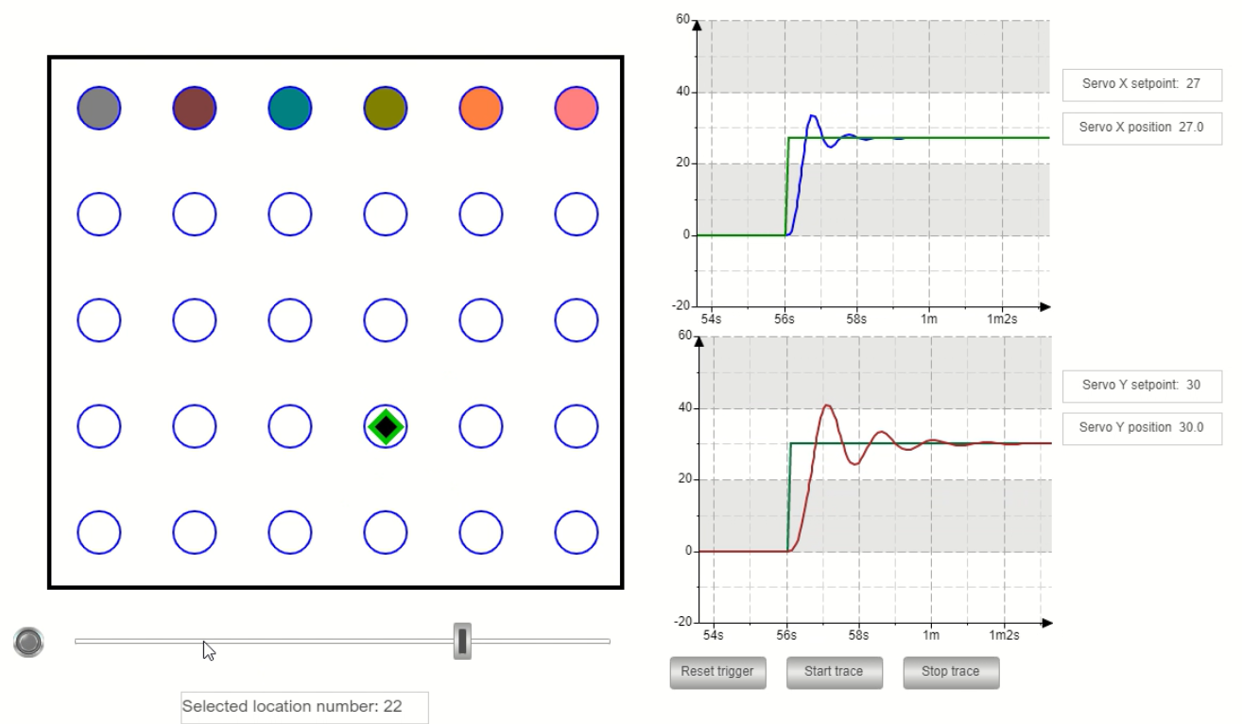
Assignment preview – adv. part.
X-Y Dosing Laboratory system
non tuned Controllers
X-direction
Y-direction
XY-servo system

Slide 22
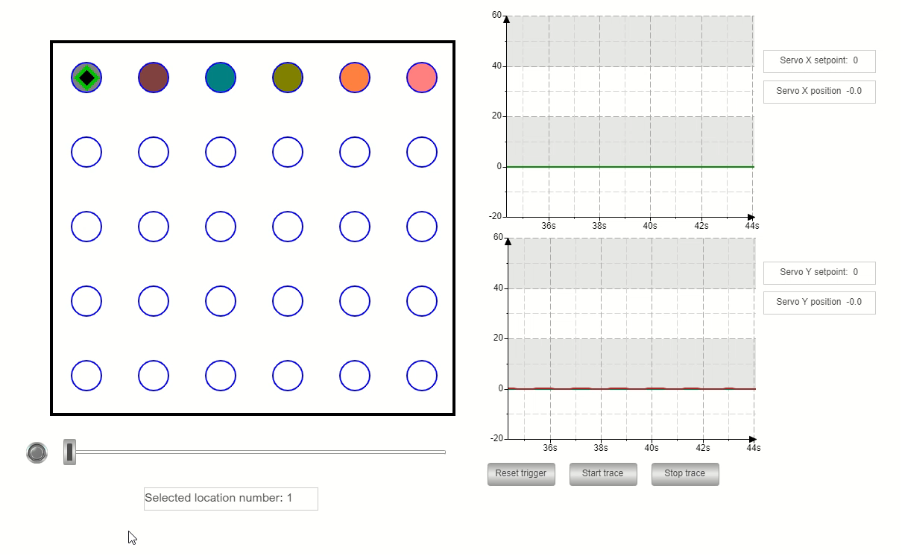
Assignment preview – adv. part.
X-Y Dosing Laboratory system
with non tuned PID Controllers

Slide 23
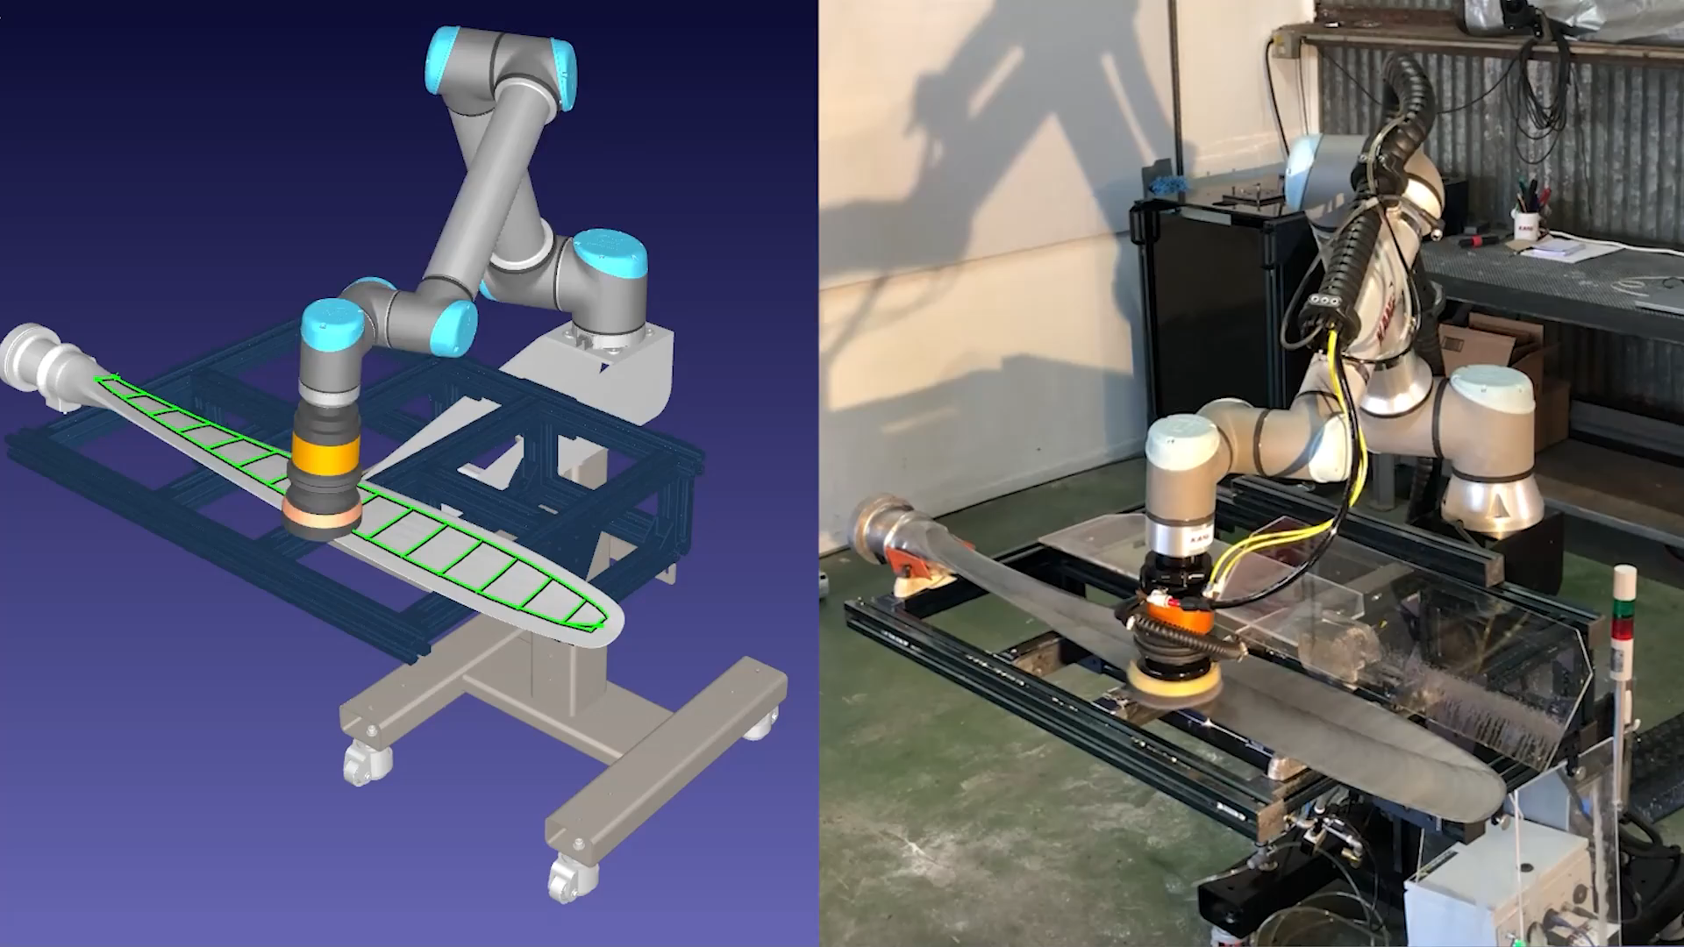

Slide 24

Questions ?

Slide 25
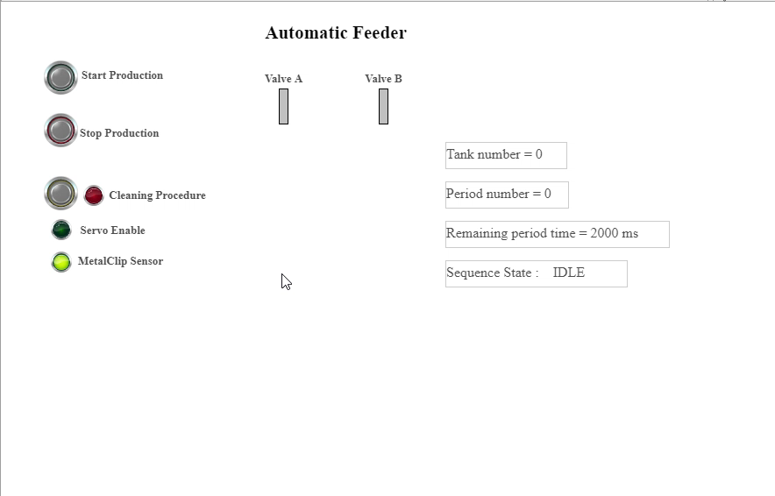

Slide 26
X-direction
1
container location 2 . . .6 : Raw materials
Y-direction
container location 7 . . .30 : Finished products
XY- Servo at location:22
Temporary added for Commissioning the system

Slide 27
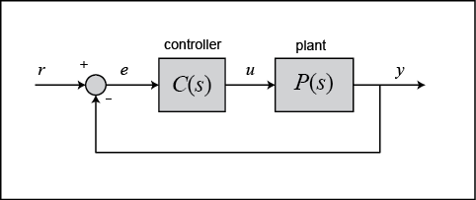
0
40
20
60
30
P-Controller
Linear Servo

